Slide 1
The Empathy Index
(formerly known as The Happiness Index)
Jose Maria Veganzones
Niti M K.C.
Peter Labus
Nasr Kasrin

Slide 2




The Team
Physicist, high performance computing guru
Musician, doesn‘t like the slide
multi-disciplinary quantitative social scientist
likes the slide but afraid
Peter
Niti
Medical Doctor / wizard
probably a spy
Atypical computer scientist / Loud guy / likes the slide
Jose Maria
Nasr

Slide 3
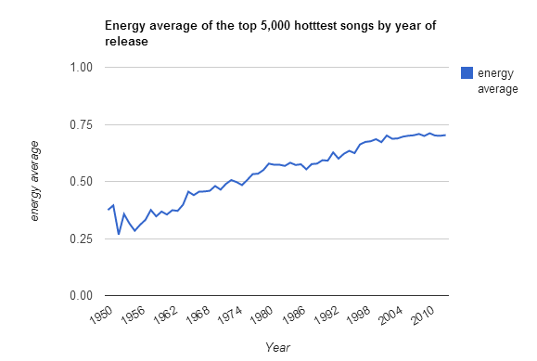
Our Initial Idea
Patterns of music releases during post-war era
Million Song dataset, Music Brainz dataset
Image ©: Echo Nest

Slide 4
Feeling with the World
How happy (or not) are different geographical locations of the world right now?
How major events spread over time and space?
Different levels of graininess
Spatial: Country, continent, planet
Temporal: day, week, month

Slide 5
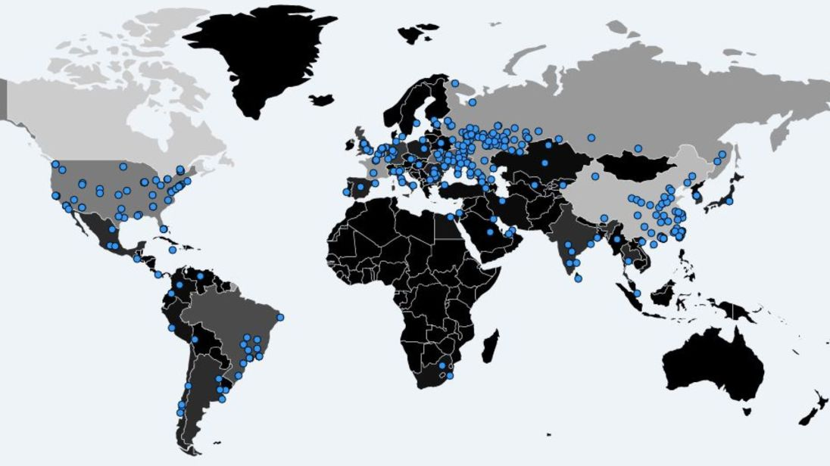
Use-case: WannaCry ransomware attack
12 – 15 May, 2017
© image: Malwaretech

Slide 6
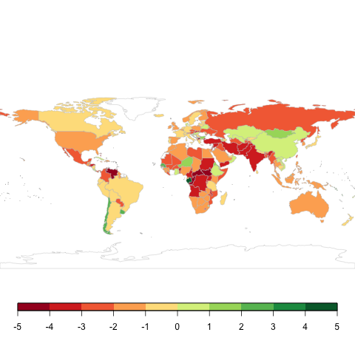
Day of attack
Notes:
<number>

Slide 7

Days around attack
Notes:
<number>

Slide 8
Most Empathy by Continent in 2017
Notes:
<number>

Slide 9
Best Index by Continent in 2017
Notes:
<number>

Slide 10
The Empathy Function
1st attempt: logic in window function
Pros: was easier to implement
Cons: memory heavy
2nd attempt: logic in the fold function for better performance
Pros: was harder to conceive
Cons: better performance

Slide 11
Spatial Graininess
Achieved simply by a helper function that is called from within the getKey
On a country level we key by country code
On a continental level the helper maps the country code to the continent code
On a world level we map everything all keys to earth

Slide 12
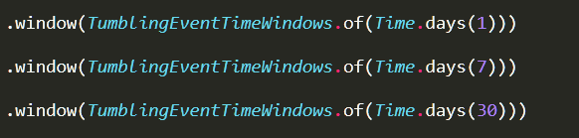
Temporal Graininess

Slide 13
Future Work
Integrating social media feeds
More levels of graininess
by continent, by country, by city
By day, week, month
Filter by type of events

